Slide 1


Northamptonshire
Talking

Slide 2

What is Northamptonshire talking?
Northamptonshire Talking is the official community messaging and engagement platform used by Northamptonshire Police. You may hear it referred to as Neighbourhood Alert; it was locally rebranded to Northamptonshire Talking a few years ago.
It allows residents to:
  Receive local policing updates specific to where they live
  Hear directly from their Neighbourhood Policing Team
  Stay informed about crime prevention, incidents, and community priorities
  Share feedback and intelligence safely and securely
The platform is also used by other information providers- Fire and Rescue service, Get safe online, Neighbourhood Watch, Office of the Police and Crime Commissioner, and Report Fraud. When signing up, you choose who you want to receive messages from.
It is free, simple to use, and resident‑led; you choose what you want to receive

Slide 3
What kind of messages do you receive? (And how we avoid spam)
Residents only receive relevant, local messages, such as:
  Crime trends and prevention advice
  Updates about incidents or policing activity
  Appeals for information or witnesses
  Local events, meetings, or initiatives
  Surveys about community concerns
How we avoid spam:
  Messages are location based- residents don’t receive county‑wide messages unless necessary
  Users choose how often they hear from us by selecting message types
  Messages are sent only by authorised police staff
  Residents can unsubscribe or change preferences at any time

Slide 4
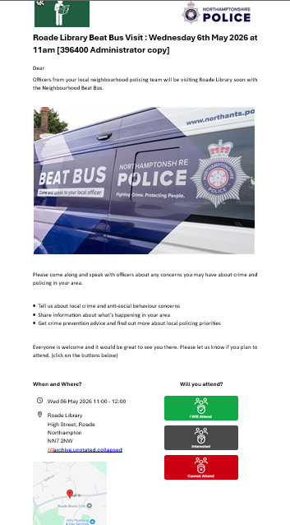
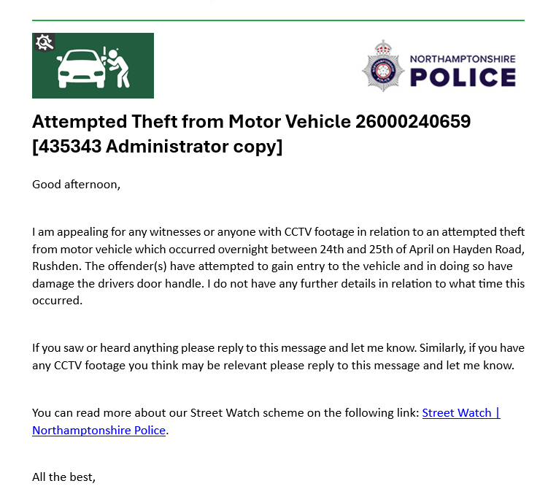
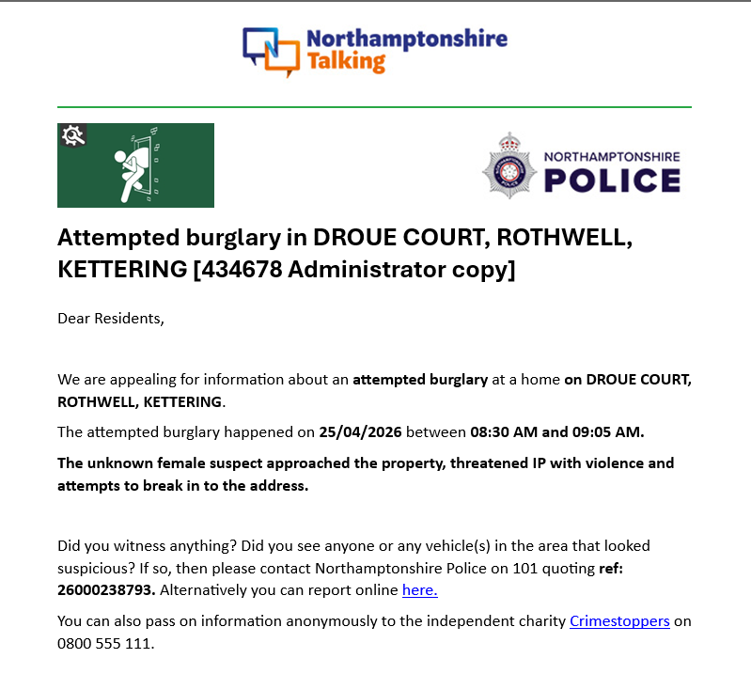
Message examples

Slide 5

How do I contact my neighbourhood officers?
Northamptonshire Talking provides a direct digital link between residents and their Neighbourhood Policing Team
How to:
  Go to the Northamptonshire Talking web page, enter your postcode and contact an officer
Or
  At the bottom of any message you receive, you can reply to the officer who sent it out
Why this matters:
  Lowers the barrier to reporting concerns
  Encourages early sharing of intelligence
  Builds trust and familiarity with local officers
  Supports problem‑solving policing

Slide 6
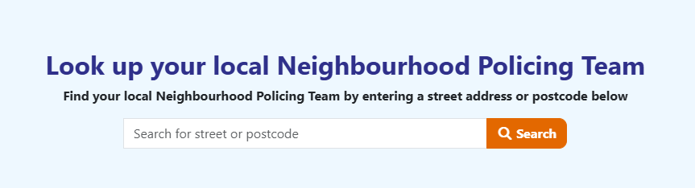
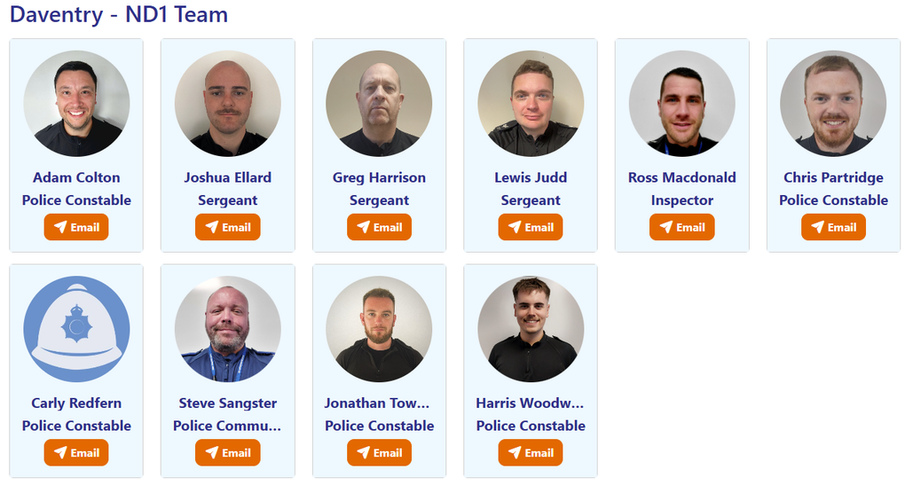
  Enter this into your search engine: https://www.northamptonshiretalking.co.uk
  2. Enter your postcode on the homepage
  3. View upcoming events and your neighbourhood team. Click on the orange email icon to contact your team.

Slide 7
What happens with my message?
When a resident sends a message through Northamptonshire Talking, it is handled carefully and professionally
What happens next:
  Messages go into a secure central inbox
  They are picked up by a police officer or trained staff member
  If needed, the message is forwarded to the appropriate team (e.g. local neighbourhood officers or specialist units)
  All information is treated confidentially and securely
  Officers can reply directly through the system
  The resident has an open, ongoing line of communication
Why this matters:
  Information reaches the right people quickly
  Residents don’t need to chase updates
  Encourages intelligence sharing that might not otherwise be reported
  Builds trust through safe, two‑way communication

Slide 8
How do I have my say through surveys?
Northamptonshire Talking is used to run short, local surveys so residents can have their say
Surveys help police understand:
  What issues matter most in each community
  How safe people feel
  Where patrols and resources should be focused
  Whether policing activity is working
Our survey examples:
  Locally Identified Priorities Survey (LIPs)- inform local priorities set every 6 months
  Surveillance survey- tell us if you have CCTV so we can contact you quickly
  Clear Hold Build area surveys

Slide 9
How do I sign up?
What is required:
  Name
  Email address and optional phone number
  Address and postcode- messaging is post code based
Signing up is quick and easy:
  Visit https://northamptonshiretalking.co.uk or provide the above details to an officer
  Enter your details
  Choose your location and interests
  Activate your account
✅ Free
✅ Takes less than 2 minutes
✅ Can be updated or cancelled at any time

Slide 10
Activating your account
After signing up to Northamptonshire Talking, residents just need to activate their account
How activation works:
  After registering, residents receive an activation email
  They simply click the link in the email to confirm their account
  Once activated, they can start receiving messages straight away
If the email doesn’t arrive:
  Check junk or spam folders
  Make sure the correct email address was entered
  Activation emails are sent automatically and securely
Why activation is important:
  Confirms the email address is correct
  Keeps accounts secure
  Ensures residents only receive messages they’ve chosen

Slide 11
FAQs
Is my information shared?- No, personal details are not shared. All data is handled securely and confidentially.
Is this an emergency contact method?- No, In an emergency, always call 999. For non‑emergencies, call 101.
Can I unsubscribe or change my preferences?- Yes, residents can change or cancel their subscription at any time.
Who sends the messages?- Messages come from Northamptonshire Police and other trusted, approved local partners residents choose to opt into.
Northamptonshire Talking puts residents in control- informed, connected, and heard.

